Slide 1

JPA & Hibernate ORM

Slide 2
Topics
JPA and Hibernate ORM Introduction
JPA annotations
Entity Manager
Fetching and Cascading Strategies
JPQL and Criteria API
Repository Pattern

Slide 3
Jpa and Hibernate ORM Introduction

Slide 4
Objectives
Understand what ORM is.
Understand what JPA and Hibernate are and their relationship.
Understand the benefits of using JPA/Hibernate.

Slide 5
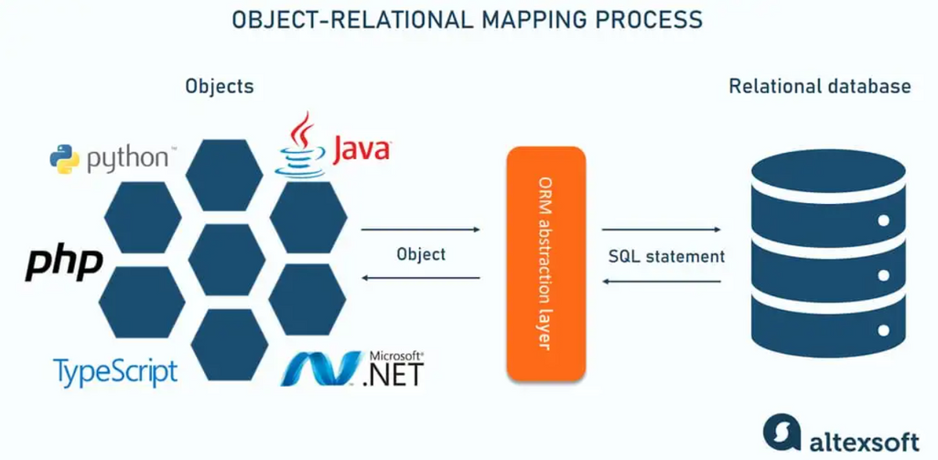
ORM
Object Relational Mapping (ORM) is a technique used in creating a "bridge" between object-oriented applications and relational databases.

Slide 6
Problem
In Java we work with objects, databases we work with tables.
So how do you take a Java object…
…and save it into a database table?
We could use JDBC and write SQL manually for everything — but it’s repetitive, error-prone, and a lot of work.
Product product = new Product(1L, “Macbook Pro M4”, “Laptop”);
INSERT INTO products (id, name, category) VALUES (1L, ‘Macbook Pro M4’, ‘Laptop’);

Slide 7
The JDBC way
Product product = new Product();
product.setProductName("Macbook Pro M4");
product.setCategory("Laptop");
String sql = "INSERT INTO products (id, name, category) VALUES (?, ?, ?)"
// 2. Prepare SQL statement
ps = conn.prepareStatement(sql);
// 3. Bind parameters
ps.setLong(1, product.getId());
ps.setString(2, product.getName());
ps.setString(3, product.getCategory());
// 4. Execute
ps.executeUpdate();

Slide 8
The ORM way
ORM automatically generates SQL and maps Java objects to database tables.
Example:
When you write:
Hibernate (an ORM) will generate SQL for you:
Product product = new Product();
product.setProductName("Macbook Pro M4");
product.setCategory("Laptop");
em.persist(product);
em.getTransaction().commit();
INSERT INTO products (id, name, category) VALUES (1L, ‘Macbook Pro M4’, ‘Laptop’);

Slide 9


ORM lets you work with the database using Java objects instead of SQL statements.
Instead of writing this:
You do this:
And the result is already mapped to Product p, no more manual mapping of resultset.

Slide 10
JDBC mapping resultset
while (rs.next()) {
int id = rs.getInt("id");
String name = rs.getString("name");
String category = rs.getString("category");
Product product = new Product();
student.setId(id);
student.setName(name);
student.setCategory(age);
}

Slide 11
What is JPA?
JPA stands for Java Persistence API.
Persistence = object state stored beyond program execution
API = the standardized set of interfaces and annotations
JPA (Java Persistence API) is a standard specification that defines how Java objects are mapped to and persisted in relational database tables.
JPA is a standard of doing Object Relation Mapping (ORM) in java.

Slide 12
Hibernate
Hibernate is an ORM framework that implements the JPA specification.
When you call the find method of EntityManager (interface from the JPA package):
Hibernate is the one who actually:
opens the database connection
generates the SELECT statement
maps the results to the Student object
closes the connection
Student student = em.find(Student.class, 1L);

Slide 13
Reasons to Use JPA
Developer Productivity
Automatic SQL generation
automatic mapping/binding
APIs for CRUD operations
reduces boilerplate code.
2. ORM and Database Independent
JPA allows you to switch between any JPA-compliant ORM providers, such as Hibernate, EclipseLink, or DataNucleus, without changing application code.
It also allows you to change databases simply by updating the SQL driver.
Implementations are abstracted by JPA APIs (EntityManager, Criteria API) and JPQL.
3. Performance
Caching(Reduced database access), Fetching and Cascading Strategies

Slide 14



Summary
ORM
idea or technique
JPA
standards
Hibernate
the tool that follows those standards and does the implementation

Slide 15
Hibernate Setup and Database Connection

Slide 16
Prerequisite
Maven is already installed. You can verify by opening a terminal and running “mvn -version”.
Database Server is running.
note the url, username, and password of your database

Slide 17
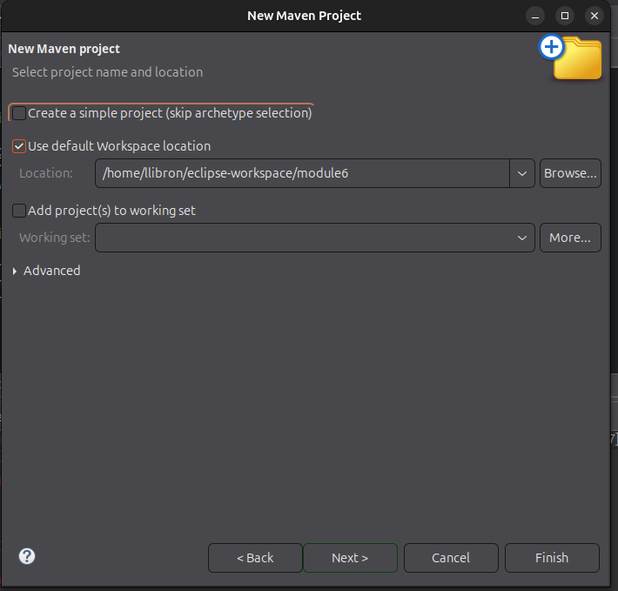
Create Maven Project

Slide 18
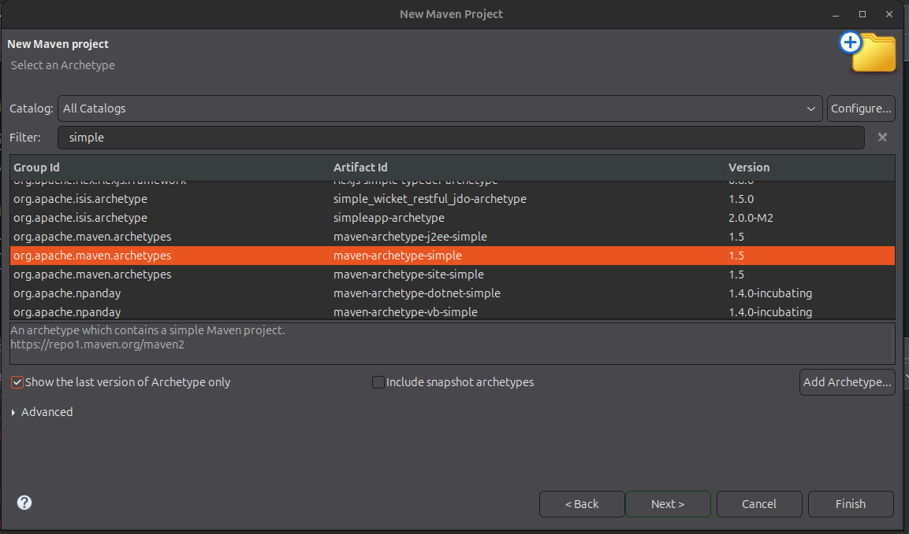
Create Maven Project

Slide 19
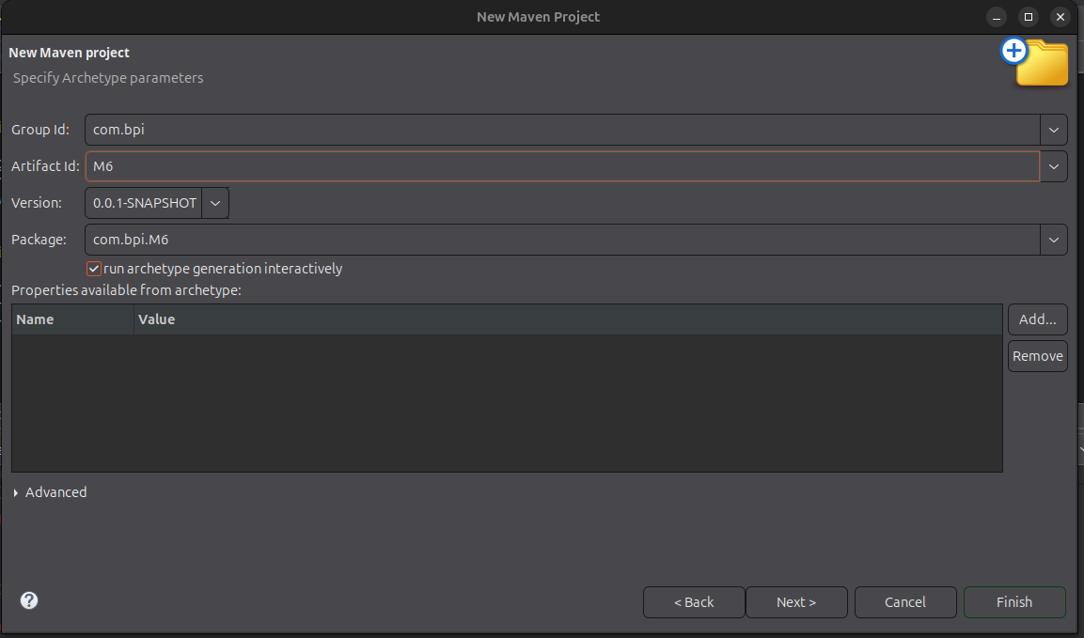
Create Maven Project

Slide 20
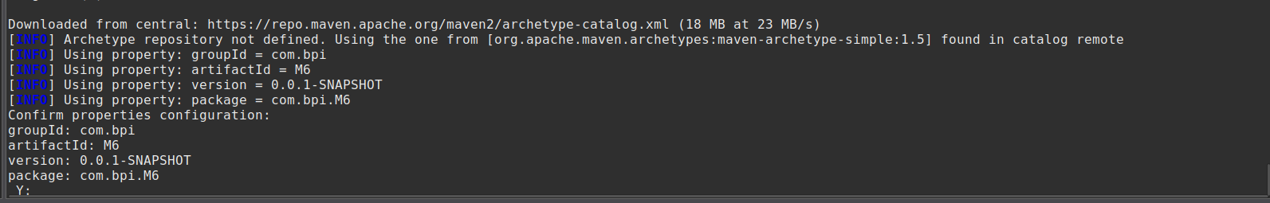
Create Maven Project
After Maven downloads the project, it will prompt you to check the project details. Type 'Y' and press Enter to confirm.

Slide 21
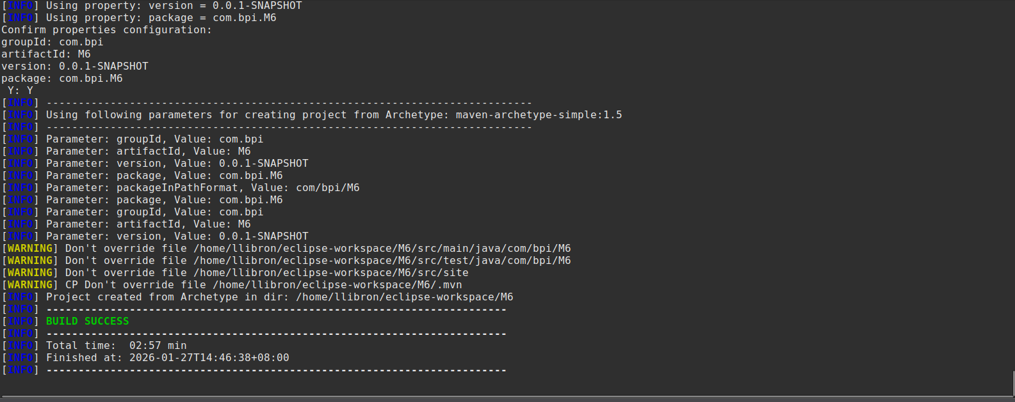
Create Maven Project

Slide 22
Setting up - pom.xml
Add Dependencies in pom.xml
Include the database driver and Hibernate in the dependencies
run “maven clean install”
<dependencies>
<!-- https://mvnrepository.com/artifact/org.hibernate.orm/hibernate-core -->
<dependency>
<groupId>org.hibernate.orm</groupId>
<artifactId>hibernate-core</artifactId>
<version>7.1.11.Final</version>
</dependency>
<!-- https://mvnrepository.com/artifact/org.postgresql/postgresql -->
<dependency>
<groupId>org.postgresql</groupId>
<artifactId>postgresql</artifactId>
<version>42.7.8</version>
</dependency>
</dependencies>

Slide 23

Setting up - persistence.xml
2. Add resources/META-INF/persistence.xml in src/main
create a folder named META-INF in resource directory
create a file inside META-INF named persistence.xml
reference: https://github.com/enzolibronexist/module6/blob/setup/src/main/resources/META-INF/persistence.xml

Slide 24
Setting up - persistence.xml
<?xml version="1.0" encoding="UTF-8"?>
<persistence xmlns="https://jakarta.ee/xml/ns/persistence"
xmlns:xsi="http://www.w3.org/2001/XMLSchema-instance"
xsi:schemaLocation="https://jakarta.ee/xml/ns/persistence
https://jakarta.ee/xml/ns/persistence/persistence_3_0.xsd"
version="3.0">
//persistence unit tells JPA how to connect to the database, which entities to manage, and which settings to use.
<persistence-unit name="default"
transaction-type="RESOURCE_LOCAL">
<provider>org.hibernate.jpa.HibernatePersistenceProvider</provider>
<properties>
<!-- JDBC connection -->
<property name="jakarta.persistence.jdbc.driver" value="org.postgresql.Driver" />
<property name="jakarta.persistence.jdbc.url" value="jdbc:postgresql://localhost:5432/sandboxdb" />
<property name="jakarta.persistence.jdbc.user" value="user" />
<property name="jakarta.persistence.jdbc.password" value="password" />
<!-- Hibernate dialect -->
<property name="hibernate.dialect" value="org.hibernate.dialect.PostgreSQLDialect" />
<property name="hibernate.hbm2ddl.auto" value="none" />
<property name="hibernate.show_sql" value="true" />
</properties>
</persistence-unit>
</persistence>

Slide 25
Create a Utility class for Entity Manager
public class EntityManagerUtil {
private static EntityManagerUtil instance;
private final EntityManagerFactory emf;
private EntityManagerUtil() {
this.emf = Persistence.createEntityManagerFactory("default");
}
public static synchronized EntityManagerUtil getInstance() {
if (instance == null) {
instance = new EntityManagerUtil();
}
return instance;
}
public EntityManager createEntityManager() {
return emf.createEntityManager();
}
public boolean isOpen(EntityManager em) {
return em != null && em.isOpen();
}
public void closeEntityManager(EntityManager em) {
if (isOpen(em)) {
em.close();
}
}
public void shutdownFactory() {
if (emf.isOpen()) {
emf.close();
}
}
}

Slide 26
In the main application
public class App {
public static void main(String[] args) {
testConnection();
}
static void testConnection() {
EntityManager em = EntityManagerUtil.getInstance().createEntityManager();
try {
if(em.isOpen()) {
System.out.println("entity manager open, ready to create transaction");
}
} finally {
EntityManagerUtil.getInstance().closeEntityManager(em);
EntityManagerUtil.getInstance().shutdownFactory();
}
}
}

Slide 27
Run the application
Run the application and check if it works. You should see the following in the console log:
Jan 24, 2026 8:59:02 PM org.hibernate.jpa.internal.util.LogHelper logPersistenceUnitInformation
INFO: HHH008540: Processing PersistenceUnitInfo [name: default]
Jan 24, 2026 8:59:02 PM org.hibernate.Version logVersion
INFO: HHH000001: Hibernate ORM core version 7.2.0.Final
Jan 24, 2026 8:59:02 PM org.hibernate.engine.jdbc.connections.internal.DriverManagerConnectionProvider configure
WARN: HHH10001002: Using built-in connection pool (not intended for production use)
Jan 24, 2026 8:59:02 PM org.hibernate.engine.jdbc.env.internal.JdbcEnvironmentInitiator logConnectionInfo
INFO: HHH10001005: Database info:
Database JDBC URL [jdbc:postgresql://localhost:5432/sandboxdb]
Database driver: PostgreSQL JDBC Driver
Database dialect: PostgreSQLDialect
Database version: 18.0
Default catalog/schema: sandboxdb/public
Autocommit mode: false
Isolation level: READ_COMMITTED
JDBC fetch size: none
Pool: DriverManagerConnectionProvider
Minimum pool size: 1
Maximum pool size: 20
Jan 24, 2026 8:59:02 PM org.hibernate.engine.transaction.jta.platform.internal.JtaPlatformInitiator initiateService
INFO: HHH000489: No JTA platform available (set 'hibernate.transaction.jta.platform' to enable JTA platform integration)
entity manager open, ready to create transaction

Slide 28
M6_Activity1 - Project Setup
Objective:
Create a Maven project.
Add the Hibernate ORM and PostgreSQL driver dependencies to the pom.xml file.
Configure the persistence.xml file.
Create a utility class responsible for managing the EntityManager.
Use the utility class to test creating a entity manager.

Slide 29
M6_Activity1 - Output
Jan 24, 2026 8:59:02 PM org.hibernate.jpa.internal.util.LogHelper logPersistenceUnitInformation
INFO: HHH008540: Processing PersistenceUnitInfo [name: default]
Jan 24, 2026 8:59:02 PM org.hibernate.Version logVersion
INFO: HHH000001: Hibernate ORM core version 7.2.0.Final
Jan 24, 2026 8:59:02 PM org.hibernate.engine.jdbc.connections.internal.DriverManagerConnectionProvider configure
WARN: HHH10001002: Using built-in connection pool (not intended for production use)
Jan 24, 2026 8:59:02 PM org.hibernate.engine.jdbc.env.internal.JdbcEnvironmentInitiator logConnectionInfo
INFO: HHH10001005: Database info:
Database JDBC URL [jdbc:postgresql://localhost:5432/sandboxdb]
Database driver: PostgreSQL JDBC Driver
Database dialect: PostgreSQLDialect
Database version: 18.0
Default catalog/schema: sandboxdb/public
Autocommit mode: false
Isolation level: READ_COMMITTED
JDBC fetch size: none
Pool: DriverManagerConnectionProvider
Minimum pool size: 1
Maximum pool size: 20
Jan 24, 2026 8:59:02 PM org.hibernate.engine.transaction.jta.platform.internal.JtaPlatformInitiator initiateService
INFO: HHH000489: No JTA platform available (set 'hibernate.transaction.jta.platform' to enable JTA platform integration)
entity manager open, ready to create transaction

Slide 30
JPA Annotations

Slide 31
Objectives
Understand what Entities are
Learn to use JPA Annotations to:
Create Entities
Map entity fields to table columns
Model entity relationships

Slide 32
Java Annotations
Java annotations are labels you attach to code (classes, methods, fields, etc.) to provide extra information to the compiler or frameworks/libraries (Hibernate).
They do not change the logic of the code.
Instead, they tell the compiler, tools and frameworks(like Hibernate) how to treat your code.
By using annotations, you can significantly reduce boilerplate code—they replace repetitive configuration and setup (like XML or manual wiring) with simple, declarative metadata, making the code cleaner, shorter, and easier to maintain.

Slide 33
Java Annotations Sample
//Class-level annotation
@SuppressWarnings("all") // suppress compiler warnings for the whole class
public class Calculator {
// Field-level annotation
@Deprecated // marks the field as outdated
private int lastResult;
private String name = "Simple Calculator";
// Method-level annotations
@Override // indicates we are overriding a method from Object
public String toString() {
return name + " (lastResult=" + lastResult + ")";
}
@Deprecated // mark method as outdated
public int add(int a, int b) {
lastResult = a + b;
return lastResult;
}
@SuppressWarnings("unused") // suppress warnings in this method
public int multiply(int a, int b) {
lastResult = a * b;
return lastResult;
}
}

Slide 34
JPA Annotations
JPA annotations are used to map Java classes to database tables and define relationships, constraints, and behaviors for entity classes.
What are Entities in JPA?
Entities in JPA are java objects representing data that can be persisted in the database.
An entity class represents a table. Every instance of an entity class represents a row in the table.
Entity Representation:
Entity class → Database table
Entity fields inside the entity class → Table column
Entity object (instance of entity class) → A row in the table

Slide 35
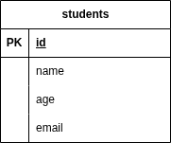
Entity class
@Entity
@Table(name = "students")
public class Student {
@Id
private Long id;
private String name;
private int age;
private String email;
}
For example, Student class is an entity class because it represents the students table in the database

Slide 36
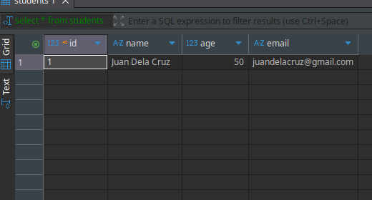
Entity object
Student newStudent = new Student();
newStudent.setName("Juan Dela Cruz");
newStudent.setAge(50);
newStudent.setEmail("juandelacruz@gmail.com");
The object newStudent, instantiated from the Student entity class, is an entity object and represents a row in the database when it is persisted.

Slide 37
@Entity
Marks a class as an entity class, making objects instantiated from this class eligible for persistence.
Example:
By default, hibernate uses the class name as the table and entity name. In our example, hibernate will translate it as “Student”
What if the table in the database have a different name, let say “students”?
@Entity
public class Student {}

Slide 38
@Table
In most cases, the name of the table in the database and the name of the entity won’t be the same
In these cases, we can specify the table name using this annotation
for example:
@Entity
@Table(name = "students")
public class Student {}

Slide 39
@Id
@Id is a JPA annotation used to mark the primary key of an entity.
Every JPA entity class must have exactly one primary key because JPA uses it to:
Identify each entity instance
Track changes
Manage caching
Perform updates and deletion correctly
An error will occur if the entity does not have a field annotated with @Id.
Caused by: org.hibernate.AnnotationException: Entity 'com.bpi.module6.model.Product' has no identifier (every '@Entity' class must declare or inherit at least one '@Id' or '@EmbeddedId' property)

Slide 40
@Id
Example:
@Entity
@Table(name = "students")
public class Student {
@Id
private Long id;
}
What if the primary key in the students table has a different name? For example, “student_id”
We can explicitly map the entity field detail to the table column detail by using @Column

Slide 41
@Column
@Column is a JPA annotation used to explicitly specify the mapping of a entity field to a database column.
By default, Hibernate maps entity fields to columns with the same name, but @Column lets you:
Specify a different column name
Define constraints like nullable or unique
Specify the length, precision, and scale
Specify SQL type with columnDefinition

Slide 42
@Column
For example our columns look like this:
CREATE TABLE students (
student_id SERIAL PRIMARY KEY NOT NULL,
student_name VARCHAR(50) NOT NULL,
student_age INT,
email VARCHAR(100) UNIQUE
);
We will explicitly map the details using @Column attributes
@Id
@Column(name = "student_id")
private Long id;
@Column(name = "student_name", nullable = false, length = 50, columnDefinition = "VARCHAR(50)")
private String name;
@Column(name = "age", columnDefinition = "INT")
private int age;
@Column(name = "email", unique = true, length = 100, columnDefinition = "VARCHAR(100)")
private String email;

Slide 43
@Column
Attribute | Purpose
name | Maps the field to a specific column name (product_name in this case).
nullable | Whether the column can accept NULL values (false means NOT NULL).
length | Maximum length of String fields.
unique | Whether the column should have a UNIQUE constraint.
precision | Total number of digits for numeric fields.
scale | Number of digits after the decimal point for numeric fields.
columnDefinition | Custom SQL column type (overrides default mapping).

Slide 44
Implicit vs Explicit Mapping
Implicit mapping means you do not specify mapping details, and Hibernate uses default conventions.
For example:
What Hibernate assumes (by default):
Table name → Student
Column name → id, name, age, email
Column type: inferred from Java type
String → VARCHAR(255)
int → INTEGER
Long → BIGINT
@Entity
public class Student {
@Id
private Long id;
private String name;
private int age;
private String email;
}

Slide 45
Implicit
Pros of implicit mapping
Less code
Faster to write
Good for simple projects or prototype
Cons of implicit mapping
Less Control
Defaults vary between providers (Hibernate, EclipseLink)
Unpredictable in naming strategy, unless naming strategy is configured in persistence.xml

Slide 46
Explicit
Explicit mapping means you specify how entity classes and fields map to database tables and columns using annotations.
For example:
@Entity
@Table(name = "students")
public class Student {
@Id
@Column(name = "id")
@GeneratedValue(strategy = GenerationType.IDENTITY)
private Long id;
@Column(name = "name", nullable = false, length = 50, columnDefinition = "VARCHAR(50)")
private String name;
@Column(name = "age", columnDefinition = "INT")
private int age;
@Column(name = "email", unique = true, length = 100, columnDefinition = "VARCHAR(100)")
private String email;
//getters and setters
}

Slide 47
Explicit
Pros of explicit mapping
Predictable behavior
Database-friendly naming
Safer for production
Cons of implicit mapping
More annotations
More boilerplate/code

Slide 48
@GeneratedValue
@GeneratedValue is a annotation used on primary key fields of an entity to indicate that the value of the primary key should be generated automatically by the persistence provider (like Hibernate) or the database.
Without it, you would need to manually assign a unique ID to each entity.
For Example:
Here, you don’t have to set id manually when creating a new Product. When the entity is persisted, JPA automatically generates it.
@Id
@Column(name = "id")
@GeneratedValue
private Long id;

Slide 49
@GeneratedValue GenerationType
GenerationType / Method | How it works | Database Example / Notes | When to use
AUTO | JPA chooses the strategy based on database dialect | MySQL → IDENTITY, PostgreSQL → SEQUENCE | Database portability if you don’t care about exact strategy
IDENTITY | Database auto-increments the value | MySQL AUTO_INCREMENT, SQL Server IDENTITY, POSTGRES SERIAL | Simple numeric PKs; may affect batch inserts
SEQUENCE | Uses a database sequence | Oracle, PostgreSQL | Control over sequences; supports prefetching for performance
TABLE | Uses a special table to generate unique IDs | Any DB, slower than SEQUENCE | For DBs that don’t support sequences or identity columns
UUID | Generates a 128-bit globally unique identifier | Can use Hibernate UUIDGenerator or Java UUID.randomUUID() | When you need unique IDs across systems, or you want non-guessable IDs

Slide 50
Explicitly Set GenerationType
For example:
@Id
@Column(name = "id")
@GeneratedValue(strategy = GenerationType.IDENTITY)
private Long id;
or
@Id
@Column(name = "id")
@GeneratedValue(strategy = GenerationType.UUID)
private Long id;

Slide 51
Add entity in Persistence.xml
<persistence-unit name="default" transaction-type="RESOURCE_LOCAL">
<class>com.bpi.module6.model.Student</class>
</persistence-unit>

Slide 52
M6_Activity2 - JPA Core Annotations
Create a Student entity class, mapping the students table you created in Module 5 Exercise #3
Explicitly map the database table name using @Table and also explicitly map the column details using @Column.
( ex. @Column(columnDefinition=”VARCHAR(100)”, unique=”true”) )
Use @GeneratedValue to automatically generate primary key values.
Explicitly set the generation type ( ex. strategy = GenerationType.IDENTITY )
Create a transaction using EntityManager and persist a student entity.

Slide 53
Create a transaction and persist a student entity
public class App {
public static void main(String[] args) {
EntityManager em = EntityManagerUtil.getInstance().createEntityManager();
try {
runM6Activity2(em);
} finally {
EntityManagerUtil.getInstance().closeEntityManager(em);
EntityManagerUtil.getInstance().shutdownFactory();
}
}
static void runM6Activity2(EntityManager em) {
try {
em.getTransaction().begin();
Student newStudent = new Student();
newStudent.setName("Juan Dela Cruz");
newStudent.setAge(50);
newStudent.setEmail("juandelacruz@gmail.com");
em.persist(newStudent);
em.getTransaction().commit();
}
}
}

Slide 54
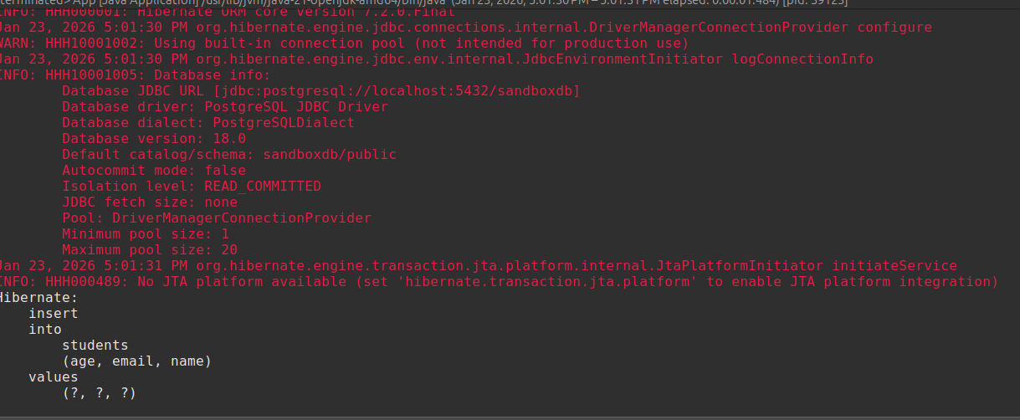
M6_Activity2 - Expected Output (Console)

Slide 55
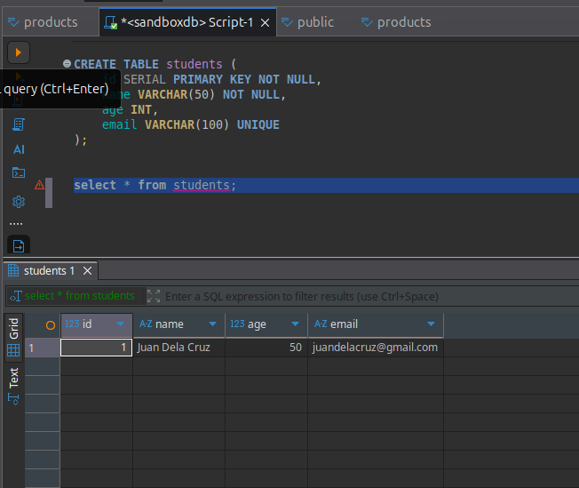
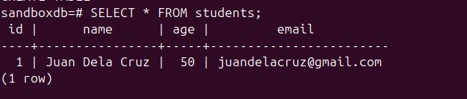
M6_Activity2 - Expected Output (Database)

Slide 56
Relationship Annotations

Slide 57
Relationship Annotations
JPA lets you describe how entity classes relate to each other — similar to how database tables have relationships.
The main relationship types are:
@OneToOne
@OneToMany
@ManyToOne
@ManyToMany

Slide 58
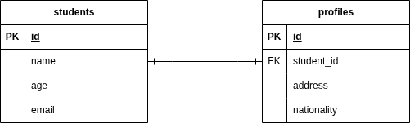
@OneToOne
An entity instance may be associated with at most one instance of another entity.
For example:
Each Student entity instance is associated with at most one Profile entity instance.

Slide 59
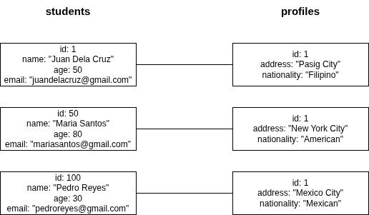
@OneToOne

Slide 60
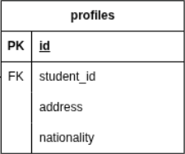
@OneToOne Implementation
@Entity
@Table(name = "profiles")
public class Profile {
@Id
@Column(name = "id")
@GeneratedValue(strategy = GenerationType.IDENTITY)
private Long id;
@Column(name = "address", columnDefinition = "VARCHAR(500)", length = 500)
private String address;
@Column(name = "nationality", columnDefinition = "VARCHAR(50)", length = 50)
private String nationality;
@OneToOne
@JoinColumn(name = "student_id")
private Student student;
//setters and getters
}

Slide 61
@JoinColumn
@OneToOne
@JoinColumn(name = "student_id")
private Student student;
@JoinColumn is an annotation that indicates that a given column in the owner entity refers to a primary key in the reference entity.

Slide 62
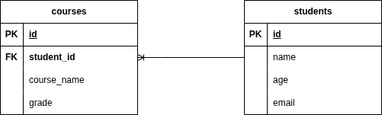
@ManyToOne
Many instances of one entity can be associated with a single instance of another entity.
For example:
Many instances of courses belongs to one instance of students.

Slide 63
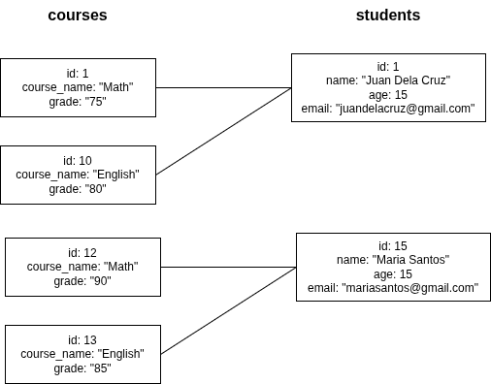
@ManyToOne

Slide 64
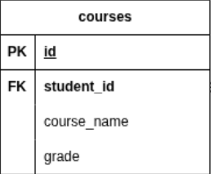
@ManyToOne
@Entity
@Table(name = "courses")
public class Course {
@Id
@Column(name = "id")
@GeneratedValue(strategy = GenerationType.IDENTITY)
private Long id;
@Column(name = "course_name", columnDefinition = "VARCHAR(50)", length = 50)
private String courseName;
@Column(name = "grade", columnDefinition = "VARCHAR(2)", length = 2)
private String grade;
@ManyToOne
@JoinColumn(name = "student_id")
private Student student;
//getters and setters
}

Slide 65
@OneToMany
One instance of an entity is associated to many instances of another entity.
For example:
One Student instance can be associated to many Course instances.

Slide 66
@OneToMany
So why use @OneToMany if there is no foreign key in the students table?
One of the use of using @OneToMany would be to point out that the foreign key is in the Course entity.
Another is to tell JPA that this side of the relationship is the inverse side by
defining the mappedBy attribute in @OneToMany annotation, so JPA doesn’t create another foreign key.
The owning side would be the Course which has the foreign key.

Slide 67
@OneToMany
@Entity
@Table(name = "students")
public class Student {
@Id
@Column(name = "id")
@GeneratedValue(strategy = GenerationType.IDENTITY)
private Long id;
@Column(name = "name", nullable = false, length = 50, columnDefinition = "VARCHAR(50)")
private String name;
@Column(name = "age", columnDefinition = "INT")
private int age;
@Column(name = "email", unique = true, length = 100, columnDefinition = "VARCHAR(100)")
private String email;
@OneToMany(mappedBy = "student")
private List<Course> courses;
//getters and setters
}

Slide 68
@OneToMany Bidirectional
Another use is to create a Bidirectional mapping so both entity classes are aware of each other and can navigate the relationship from either side. For our example, you can access all the courses in the student, and vice versa.
static void runBidirectional(EntityManager em) {
em.getTransaction().begin();
Student student = em.find(Student.class, 1L);
student.getCourses().forEach(course -> System.out.print(course.getCourseName()));
em.getTransaction().commit();
}

Slide 69
Owning Side and Inverse Side
Owning side:
Controls the foreign key
Responsible for database updates
Uses @JoinColumn
Inverse side:
Mirrors the relationship
Uses mappedBy attribute
@OneToMany(mappedBy = “student”)

Slide 70
@ManyToMany
Multiple instances of one entity are associated with multiple instances of another entity.
For example, Many instances of Student can be associated to many instances of Club

Slide 71
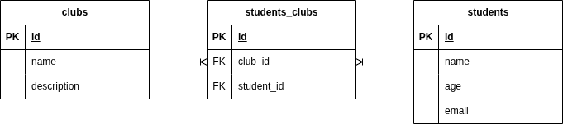
@ManyToMany

Slide 72
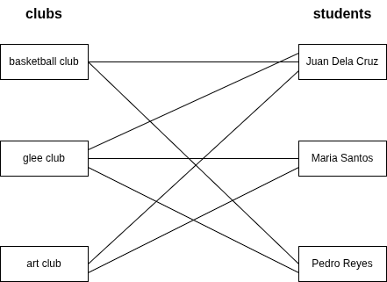
@ManyToMany

Slide 73
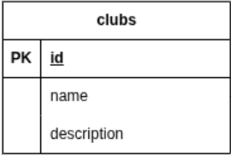
@ManyToMany - Owning Side
@Entity
@Table(name = "clubs")
public class Club {
@Id
@Column(name = "id")
@GeneratedValue(strategy = GenerationType.IDENTITY)
private Long id;
@Column(name = "name"
, unique = true
, nullable = false
, columnDefinition = "VARCHAR(50)"
, length = 50)
private String name;
@Column(name = "description", columnDefinition = "VARCHAR(500)", length = 500)
private String description;
@ManyToMany
@JoinTable(name = "students_clubs"
, joinColumns = @JoinColumn(name = "club_id")
, inverseJoinColumns = @JoinColumn(name = "student_id"))
private List<Student> students;
//getters and setters
}

Slide 74
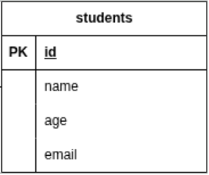
@ManyToMany - Inverse side
@Entity
@Table(name = "students")
public class Student {
@Id
@Column(name = "id")
@GeneratedValue(strategy = GenerationType.IDENTITY)
private Long id;
@Column(name = "name", nullable = false, length = 50, columnDefinition = "VARCHAR(50)")
private String name;
@Column(name = "age", columnDefinition = "INT")
private int age;
@Column(name = "email", unique = true, length = 100, columnDefinition = "VARCHAR(100)")
private String email;
@OneToMany(mappedBy = "student")
private List<Course> courses;
@ManyToMany(mappedBy = "students")
private List<Club> clubs;
//getters and setters
}

Slide 75
@ManyToMany
static void persistManyToMany(EntityManager em) {
em.getTransaction().begin();
Student student = em.find(Student.class, 1L);
Student student2 = em.find(Student.class, 2L);
Club basketballClub = new Club();
basketballClub.setName("Basketball Club");
basketballClub.setDescription("For basketball enthusiast");
List<Student> basketballClubstudentList = new ArrayList();
basketballClubstudentList.add(student);
basketballClub.setStudents(basketballClubstudentList);
em.persist(basketballClub);
Club gleeClub = new Club();
gleeClub.setName("Glee Club");
gleeClub.setDescription("For students that wants to sing");
List<Student> gleeClubstudentList = new ArrayList();
gleeClubstudentList.add(student);
gleeClubstudentList.add(student2);
gleeClub.setStudents(gleeClubstudentList);
em.persist(gleeClub);
Club artClub = new Club();
artClub.setName("Art Club");
artClub.setDescription("For students that wants to make art");
List<Student> artClubstudentList = new ArrayList();
artClubstudentList.add(student);
artClubstudentList.add(student2);
artClub.setStudents(artClubstudentList);
em.persist(artClub);
em.getTransaction().commit();
}

Slide 76
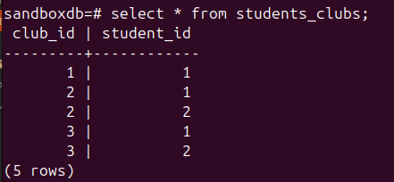
@ManyToMany - output

Slide 77
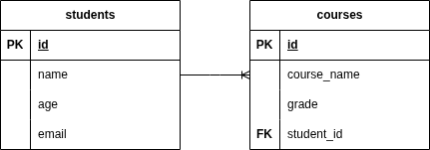
M6_Activity3 - Relationship Annotations
Objective:
Extend the existing JPA application by modeling a one-to-many relationship using @OneToMany and @ManyToOne. This activity emphasizes relationship mapping, foreign key mapping, and bidirectional mapping.
Scenario:
A Student can have many courses. This represents a one-to-many / many-to-one relationship.

Slide 78
M6_Activity3 - Relationship Annotations
Instructions: 1. Create a new entity class for courses table
Add student field and add @ManyToOne
add @JoinColumn to map the foreign key column name
2. Update student entity class
Add a courses field and use @OneToMany
since this is the inverse side add mappedBy attribute
3. Create a transaction
Begin a transaction
Assign courses to a student

Slide 79
M6_Activity3 - Transaction
static void persistOneToMany(EntityManager em) {
em.getTransaction().begin();
Student student1 = em.find(Student.class, 1L);
Course newCourse = new Course();
newCourse.setCourseName("Math");
newCourse.setGrade("80");
newCourse.setStudent(student1);
em.persist(newCourse);
em.getTransaction().commit();
}

Slide 80
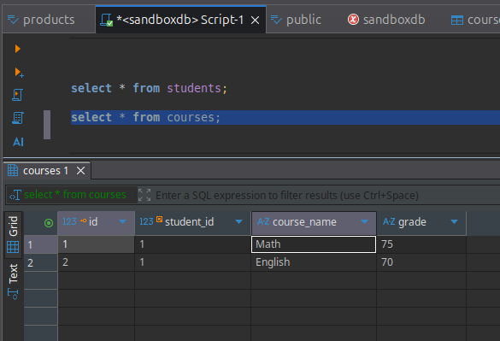
M6_Activity3 - Expected Output (Database)

Slide 81
M6_Activity3 - Expected Output (Console)
Hibernate:
select
s1_0.id,
s1_0.age,
s1_0.email,
s1_0.name
from
students s1_0
where
s1_0.id=?
Hibernate:
insert
into
courses
(course_name, grade, student_id)
values
(?, ?, ?)
Hibernate:
insert
into
courses
(course_name, grade, student_id)
values
(?, ?, ?)

Slide 82
Entity Manager

Slide 83
Entity Manager
EntityManager manages entity objects and controls how they are stored, retrieved, updated, and deleted in the database.

Slide 84
How does the Entity Manager work?
When you call persist(), find(), or merge(), EntityManager keeps track of your objects in something called the persistence context.
In the persistence context, Hibernate automatically detects entity changes and synchronizes them with the database on commit.

Slide 85
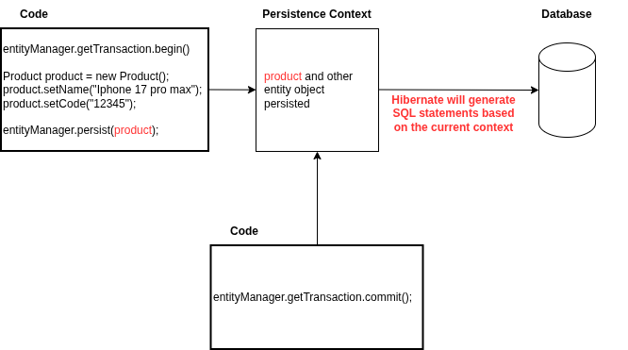
Persistence Context

Slide 86
Entity Lifecycle
Transient – normal Java object
Managed – attached to Persistence Context
Detached – was managed, but no longer tracked
Removed – scheduled for deletion

Slide 87
Entity Manager Operations

Slide 88
Persist
Persist - Adds a new entity to the persistence context and marks it for insertion into the database on flush/commit.
For Example: void persist(Object entity);
static void persistSample(EntityManager em) {
em.getTransaction().begin();
Student newStudent = new Student(); // transient
newStudent.setName("Pedro Reyes");
newStudent.setAge(23);
newStudent.setEmail("pedroreyes@gmail.com");
em.persist(newStudent); // managed
em.getTransaction().commit(); //hibernate generates insert sql, newStudent will be saved to db
System.out.println("is newStudent inside the persistence context: " + em.contains(newStudent));
}

Slide 89
Find
Find - Fetch an entity from the database using its primary key and put it inside the persistence context.
For Example: <T> T find(Class<T> entityClass, Object primaryKey);
Returns null if the entity doesn’t exist.
static void findSample(EntityManager em) {
em.getTransaction().begin();
//Hibernate retrieves the Student entity via SELECT and places it into the persistence context.
Student studentWithId1 = em.find(Student.class, 1L); //managed entity
if (studentWithId1 != null) {
System.out.println("is newStudent inside the persistence context: " + em.contains(studentWithId1));
}
em.getTransaction().commit();
}

Slide 90
Merge
Merge - Copy the state of a detached entity into the current persistence context and return a managed instance.
A common use case for merge() is when you want to update a detached entity—that is, an entity that was previously persisted but is no longer associated with the current persistence context.

Slide 91
Merge
static void mergeSample(EntityManager em) {
em.getTransaction().begin();
//Hibernate retrieves the Student entity via SELECT and places it into the persistence context.
Student studentWithId1 = em.find(Student.class, 1L); //managed entity
em.detach(studentWithId1); //detach studentWithId1
System.out.println("is studentWithId1 inside the persistence context: " + em.contains(studentWithId1));// false
// for example, studentWithId1 has changes while in detached
studentWithId1.setAge(22);
// in order for this changes to reflect in database
// we need to re attach the object to the persistence context using merge
// merge() returns a managed instance with the same persistent state
// as the given entity instance, but a distinct Java object identity.
studentWithId1 = em.merge(studentWithId1);
em.getTransaction().commit();
}

Slide 92
Remove
Remove - Marks an entity for deletion in the database.
For Example: void remove(Object entity);
Only works on managed entities. For detached entities, use merge first.
static void removeSample(EntityManager em) {
em.getTransaction().begin();
Student student = em.find(Student.class, 8L); // managed
em.remove(student);
em.getTransaction().commit();
System.out.println("is student inside the persistence context: " + em.contains(student)); // false
System.out.println(student.toString()); //detached
}

Slide 93
Refresh
Refresh - Synchronizes the state of the entity with the current database state.
void refresh(Object entity);
Discards all in-memory changes of the entity
Reloads the entity’s state from the database
Keeps the entity managed
Useful if another transaction updated the entity or if some field values are generated by the database.

Slide 94
Refresh
Use Case:
The created_at value is set by the database, and we want to retrieve it after the entity is saved.
CREATE TABLE public.students (
id SERIAL PRIMARY KEY NOT NULL,
name VARCHAR(50) NOT NULL,
age INT,
email VARCHAR(100) UNIQUE
created_at TIMESTAMP NOT NULL DEFAULT now();
);

Slide 95
Refresh
static void refreshSample(EntityManager em) {
em.getTransaction().begin();
Student newStudent = new Student();
newStudent.setName("John Mark Santos");
newStudent.setAge(21);
newStudent.setEmail("johnmarksantos@gmail.com");
em.persist(newStudent); // managed
em.getTransaction().commit(); // commit insert to database
System.out.println("BEFORE REFRESH: " + newStudent.toString()); //createdAt=null
em.refresh(newStudent); //generates select statement
System.out.println("AFTER REFRESH: " + newStudent.toString()); //createdAt=2026-01-26T15:24:36.123455Z
}

Slide 96
Detach
Detach - Detaches an entity from the persistence context
After detaching:
The entity is no longer managed
Changes to the entity won’t be persisted on flush/commit
Useful when you want to stop JPA from tracking an entity
void detach(Object entity);

Slide 97
Detach
static void detachSample(EntityManager em) {
em.getTransaction().begin();
Student student = em.find(Student.class, 1L); //managed
em.detach(student); // detached
student.setAge(100);
em.getTransaction().commit(); // no update statement generated because student is detached
}

Slide 98
Clear
Clear - Detaches all managed entities from the persistence context.
void clear();

Slide 99
Clear
static void clearSample(EntityManager em) {
em.getTransaction().begin();
Student student = em.find(Student.class, 1L); //managed
Student student1 = em.find(Student.class, 9L); // managed
System.out.println("BEFORE clear()");
System.out.println("is student inside the persistence context: " + em.contains(student)); //true
System.out.println("is student1 inside the persistence context: " + em.contains(student)); //true
em.clear(); // detaches all managed entity
System.out.println("AFTER clear()");
System.out.println("is student inside the persistence context: " + em.contains(student)); //false
System.out.println("is student1 inside the persistence context: " + em.contains(student)); //false
em.getTransaction().commit();
}

Slide 100
Contains
Contains - Determine if the given object is a managed entity instance belonging to the current persistence context.
boolean contains(Object entity);
For Example:
System.out.println("is newStudent student the persistence context: " + em.contains(student));

Slide 101
Commit vs Flush
Flush()
Forces Hibernate to execute SQL statements immediately for all pending changes in the persistence context.
Entities remain managed in memory.
Transaction is still open, so you can rollback if needed.
Commit()
Automatically calls flush() to synchronize the persistence context.
Commits the transaction, making changes permanent in the database.
After commit, you cannot rollback.

Slide 102
Rollback
rollback() undoes all changes in the current transaction.
After rollback, all entities in that transaction are detached.
You must check tx.isActive() before rollback to avoid exceptions.
Persistence context is cleared for rolled-back entities.

Slide 103
static void rollbackSample(EntityManager em) {
EntityTransaction tx = em.getTransaction();
try {
tx.begin();
// first transaction
Student student = em.find(Student.class, 1L);
student.setAge(30);
em.flush();
//second transaction - mock error by saving data that already exist
Student newStudent = new Student();
newStudent.setName("Juan Dela Cruz");
newStudent.setAge(20);
newStudent.setEmail("juandelacruz@gmail.com");
em.persist(newStudent);
tx.commit();
} catch (Exception e) {
System.out.println("Exception occurred: " + e.getMessage());
if (tx.isActive()) { // always check if transaction is active before calling rollback;
tx.rollback();
System.out.println("Transaction rolled back.");
}
}
}

Slide 104
Rollback - output
Exception occurred: could not execute statement [ERROR: duplicate key value violates unique constraint "students_email_key"
Detail: Key (email)=(juandelacruz@gmail.com) already exists.] [insert into students (age,email,name) values (?,?,?)]
Transaction rolled back.

Slide 105
M6_Activity4 - Entity Manager
Objective:
At the end of this activity, you will be able to use JPA EntityManager operations to perform CRUD actions and manage entity lifecycle states within a persistence context.

Slide 106
static void m6Activity4Solution(EntityManager em) {
em.getTransaction().begin();
// 1. create Student object, assign values
// 2. attach transient student object to persistence context
// 3. call flush()
// 4. detach the managed newStudent from the persistence context
// 5. print "is newStudent inside the persistence context: " + call contains()
System.out.println("is newStudent inside the persistence context: " + em.contains(newStudent));
// 6. reattach the detached newStudent
// 7. update newStudent, change some values like age or email
// 8. call flush()
// 9. print "is newStudent inside the persistence context: " + call contains()
// 10. mark managed newStudent for deletion
// 11. call flush()
// 12. print "is newStudent inside the persistence context: " + call contains()
em.getTransaction().commit();
}

Slide 107
M6_Activity4 - Output (Console)
Hibernate:
insert
into
students
(age, email, name)
values
(?, ?, ?)
is newStudent inside the persistence context: false
Hibernate:
select
s1_0.id,
s1_0.age,
s1_0.created_at,
s1_0.email,
s1_0.name
from
students s1_0
where
s1_0.id=?
Hibernate:
update
students
set
age=?,
email=?,
name=?
where
id=?
is newStudent inside the persistence context: true
Hibernate:
delete
from
students
where
id=?
is newStudent inside the persistence context: false

Slide 108
Fetching and Cascading Strategies

Slide 109
Objectives
Understand what fetching and cascading strategies are in JPA
Learn the different Fetching and Cascade Types

Slide 110
Fetching Strategies
Fetching Strategy decides when JPA/Hibernate loads related entities from the database.
There are two strategies:
EAGER – Load related entity immediately with the parent entity.
LAZY – Load related entity only when accessed.

Slide 111
FetchType.LAZY
To set fetch type LAZY:
Now, when retrieving products, categories are not loaded until getCategories() is called.
@Entity
@Table(name = "products")
public class Product {
@ManyToOne(fetch = FetchType.LAZY)
@JoinColumn(name = "category_id")
private Category category;
}

Slide 112
FetchType.EAGER
To set fetch type EAGER:
Now, when retrieving products, categories are loaded eagerly.
@Entity
@Table(name = "products")
public class Product {
@ManyToOne(fetch = FetchType.EAGER)
@JoinColumn(name = "category_id")
private Category category;
}

Slide 113
When to Use Each FetchType
EAGER: Use for small, always-needed relationships.
LAZY: Use for large collections or optional relationships to improve performance.

Slide 114
What is Cascading in JPA?
Cascading defines what happens to related entities when you perform operations on the parent entity.
Operations include: PERSIST, MERGE, REMOVE, REFRESH, DETACH.

Slide 115
Cascade Types
Cascade Type | Meaning | Example
PERSIST | Save child when parent is saved | entityManager.persist(parent)
MERGE | Update child when parent is updated | entityManager.merge(parent)
REMOVE | Delete child when parent is deleted | entityManager.remove(parent)
REFRESH | Refresh child when parent is refreshed | entityManager.refresh(parent)
DETACH | Detach child when parent is detached | entityManager.detach(parent)

Slide 116

CascadeType.ALL
CascadeType.ALL = all operations (PERSIST, MERGE, REMOVE, REFRESH, DETACH) apply to orders.

Slide 117
Java Persistence Query Language (JPQL)

Slide 118
Objectives
Understand the Purpose of JPQL
Write Basic JPQL queries
Query Entity Relationships
Control and Shape Query Results

Slide 119
What is JPQL?
JPQL (Java Persistence Query Language) is a query language used with JPA to retrieve and manipulate data.
Similar to SQL in syntax
Operates on entities and their fields
Independent of the underlying database

Slide 120
JPQL vs SQL
JPQL
Queries entities
Uses entity fields
Database-independent
SQL
Queries tables
Uses column names
Database specific
For example:
SELECT * FROM Student u; //JPQL
SELECT * FROM users; //SQL

Slide 121
WHERE Clause and Named Parameters
Where Clause:
String jpql = "Select s FROM Student s WHERE s.age >= 21";
TypedQuery<Student> query = em.createQuery(jpql, Student.class);
List<Student> students = query.getResultList();
Named Parameters:
String jpql = "Select s FROM Student s WHERE s.name = :name";
TypedQuery<Student> query = em.createQuery(jpql, Student.class);
query.setParameter("name", name);
List<Student> students = query.getResultList();

Slide 122
Basic JPQL Structure
SELECT e FROM EntityName e;
EntityName → Java entity class name
e → alias used in the query
SELECT e FROM Employee e;
Retrieves all Employee entities
Equivalent to: SELECT * FROM employee
retrieves all columns

Slide 123
EntityManager createQuery();
TypedQuery<T> createQuery(String qlString, Class<T> resultClass);
static void selectAllStudent(EntityManager em) {
em.getTransaction().begin();
String jpql = "Select s FROM Student s";
TypedQuery<Student> query = em.createQuery(jpql, Student.class);
List<Student> students = query.getResultList();
//print student names
students.forEach(student -> System.out.println(student.getName()));
em.getTransaction().commit();
}

Slide 124
Positional Parameters
static void selectStudentByNamePositionalParamaters(EntityManager em, String name, int age) {
em.getTransaction().begin();
String jpql = "Select s FROM Student s WHERE s.name = ?1 AND age = ?2";
TypedQuery<Student> query = em.createQuery(jpql, Student.class);
query.setParameter(1, name);
query.setParameter(2, age);
List<Student> students = query.getResultList();
//print student names
students.forEach(student -> System.out.println(student.getName()));
em.getTransaction().commit();
}
Positional parameters are placeholders in a JPQL query that are identified by numbers (?1, ?2, etc.), and you bind values to them by position, not by name.

Slide 125
Selecting Specific Fields
static void selectAllStudentEmails(EntityManager em) {
em.getTransaction().begin();
String jpql = "Select s.email FROM Student s";
TypedQuery<String> query = em.createQuery(jpql, String.class);
List<String> studentEmails = query.getResultList();
//print student emails
studentEmails.forEach(email -> System.out.println(email));
em.getTransaction().commit();
}
Queries all student emails and stores them in a list.
Hibernate:
select
s1_0.email
from
students s1_0
mariasantos@gmail.com
johnmarksantos@gmail.com
juandelacruz@gmail.com
janedoe@gmail.com

Slide 126
JOIN in JPQL
JOIN is used to fetch related entities via their associations.
Works with @OneToOne, @OneToMany, @ManyToOne, @ManyToMany.
JPQL Join Types
JOIN → INNER JOIN by default
LEFT JOIN → LEFT OUTER JOIN
FETCH JOIN → loads associated entities eagerly in the same query

Slide 127
INNER JOIN
static List<Student> selectAllStudentsAndCoursesInnerJoin(EntityManager em) {
List<Student> students = em.createQuery("SELECT s FROM Student s JOIN s.courses", Student.class)
.getResultList();
return students;
}

Slide 128
INNER JOIN (Multiple)
static List<Student> selectAllStudentsAndCoursesInnerJoinMultiple(EntityManager em) {
List<Student> students = em
.createQuery("SELECT s FROM Student s JOIN s.courses JOIN s.profile JOIN s.clubs", Student.class)
.getResultList();
return students;
}

Slide 129
INNER JOIN (Multiple)
Hibernate:
select
s1_0.id,
s1_0.age,
s1_0.created_at,
s1_0.email,
s1_0.name
from
students s1_0
join
courses c1_0
on s1_0.id=c1_0.student_id
join
profiles p1_0
on s1_0.id=p1_0.student_id
join
students_clubs c2_0
on s1_0.id=c2_0.student_id

Slide 130
LEFT JOIN
static List<Student> selectAllStudentsAndCoursesLeftJoin(EntityManager em) {
List<Student> students = em.createQuery("SELECT s FROM Student s LEFT JOIN s.courses", Student.class)
.getResultList();
return students;
}

Slide 131
RIGHT JOIN
static List<Course> selectAllStudentsAndCoursesRightJoin(EntityManager em) {
List<Course> courses = em.createQuery("SELECT c FROM Course c LEFT JOIN c.student", Course.class)
.getResultList();
return courses;
}

Slide 132
Aggregate Functions
SELECT COUNT(e) FROM Employee e
Supported functions:
COUNT
SUM
AVG
MIN
MAX

Slide 133
Aggregate Functions
static Long countStudents(EntityManager em) {
Long totalStudents = em.createQuery(
"SELECT COUNT(s) FROM Student s", Long.class
).getSingleResult();
return totalStudents;
}
static Long countStudentsWithCourses(EntityManager em) {
Long studentsWithCourses = em.createQuery(
"SELECT COUNT(DISTINCT s) FROM Student s JOIN s.courses c", Long.class
).getSingleResult();
return studentsWithCourses;
}

Slide 134
M6_Activity5 - JPQL
Objective:
Implement the following operations using JPQL and EntityManager:
//void printAllStudentNames(EntityManager em)
//Long countCoursesByStudentId(EntityManager em, Long id)
//Long countStudentsByAgeGreaterThan(EntityManager em, int age)

Slide 135

M6_Activity5 - JPQL (Output)
void printAllStudentNames()

Slide 136
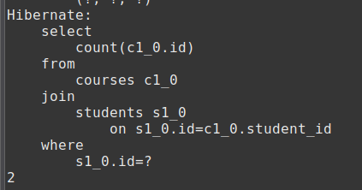
M6_Activity5 - JPQL (Output)
void countCoursesByStudentId()

Slide 137
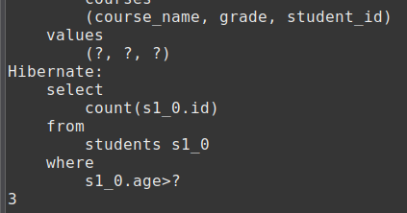
M6_Activity5 - JPQL (Output)
Long countStudentsByAgeGreaterThan(EntityManager em, int age)

Slide 138
Criteria API

Slide 139
What is Criteria API?
Criteria API is a type-safe, programmatic way to build JPA queries.
Queries are built using Java code, not strings
Can be used for dynamic queries
Reduces risk of syntax errors at runtime

Slide 140
Why Use Criteria API?
Type-safe: compiler checks field names
Dynamic queries: build queries programmatically
Safe refactoring: IDE detects renamed fields
Works well with complex queries

Slide 141
Basic Components
CriteriaBuilder → factory for building criteria queries
CriteriaQuery → represents the query
Root → represents the entity in the FROM clause
Predicate → represents WHERE conditions
TypedQuery → executes the query

Slide 142
Simple SELECT Query
static void selectAllStudent(EntityManager em) {
CriteriaBuilder cb = em.getCriteriaBuilder();
CriteriaQuery<Student> cq = cb.createQuery(Student.class);
Root<Student> root = cq.from(Student.class);
cq.select(root);
TypedQuery<Student> query = em.createQuery(cq);
List<Student> result = query.getResultList();
result.forEach(student -> System.out.println(student.getName()));
}
Selects all Student entities
Equivalent to SELECT s FROM Student s

Slide 143
WHERE Clause
static void selectStudentsWhereAgeGreaterThan21(EntityManager em) {
CriteriaBuilder cb = em.getCriteriaBuilder();
CriteriaQuery<Student> cq = cb.createQuery(Student.class);
Root<Student> root = cq.from(Student.class);
Predicate condition = cb.greaterThan(root.get("age"), 21);
cq.select(root).where(condition);
TypedQuery<Student> query = em.createQuery(cq);
List<Student> result = query.getResultList();
result.forEach(student -> System.out.println(student.getName()));
}
Filters students with age > 21

Slide 144
Selecting Specific Fields
static void selectStudentNames(EntityManager em) {
CriteriaBuilder cb = em.getCriteriaBuilder();
CriteriaQuery<String> cq = cb.createQuery(String.class);
Root<Student> root = cq.from(Student.class);
cq.select(root.get("name"));
TypedQuery<String> query = em.createQuery(cq);
List<String> result = query.getResultList();
result.forEach(studentName -> System.out.println(studentName));
}
Selects All Student Names

Slide 145
Selecting Specific Fields
static void selectStudentIdNameEmail(EntityManager em) {
CriteriaBuilder cb = em.getCriteriaBuilder();
CriteriaQuery<Object[]> cq = cb.createQuery(Object[].class);
Root<Student> root = cq.from(Student.class);
cq.select(cb.array(root.get("id"), root.get("name"), root.get("email")));
TypedQuery<Object[]> query = em.createQuery(cq);
List<Object[]> results = query.getResultList();
// Display the retrieved attributes
for (Object[] student : results) {
Long id = (Long) student[0];
String name = (String) student[1];
String email = (String) student[2];
System.out.println("id: " + id + ", name: " + name + ", email: " + email);
}
}
Selects Student id, name, and email

Slide 146
Selecting Specific Fields - Using DTO
Create a DTO class that contains the expected fields.
public class StudentDto {
private Long id;
private String name;
private String email;
public StudentDto() {
}
public StudentDto(Long id, String name, String email) {
super();
this.id = id;
this.name = name;
this.email = email;
}
//getters and setters
}

Slide 147
Selecting Specific Fields - Using DTO
static void selectStudentDto(EntityManager em) {
CriteriaBuilder cb = em.getCriteriaBuilder();
CriteriaQuery<StudentDto> cq = cb.createQuery(StudentDto.class);
Root<Student> root = cq.from(Student.class);
cq.select(
cb.construct(
StudentDto.class,
root.get("id"),
root.get("name"),
root.get("email")
)
);
TypedQuery<StudentDto> query = em.createQuery(cq);
List<StudentDto> results = query.getResultList();
// Display the retrieved attributes
for (StudentDto student : results) {
System.out.println("id: " + student.getId() +
", name: " + student.getName() +
", email: " + student.getEmail());
}
}

Slide 148
Multiple Conditions (AND / OR)
static void selectStudentMultipleWhereCondition(EntityManager em) {
CriteriaBuilder cb = em.getCriteriaBuilder();
CriteriaQuery<Student> cq = cb.createQuery(Student.class);
Root<Student> root = cq.from(Student.class);
Predicate condition1 = cb.greaterThan(root.get("age"), 21);
Predicate condition2 = cb.lessThan(root.get("age"), 60);
cq.select(root).where(cb.and(condition1, condition2));
TypedQuery<Student> query = em.createQuery(cq);
List<Student> result = query.getResultList();
result.forEach(student -> System.out.println(student.getName()));
}
AND, OR, NOT are available through CriteriaBuilder

Slide 149
ORDER BY Clause
cq.select(root).orderBy(cb.asc(root.get("name"))); // ascending
cq.select(root).orderBy(cb.desc(root.get("salary"))); // descending
static void selectStudentOrderBy(EntityManager em) {
CriteriaBuilder cb = em.getCriteriaBuilder();
CriteriaQuery<Student> cq = cb.createQuery(Student.class);
Root<Student> root = cq.from(Student.class);
cq.select(root).orderBy(cb.desc(root.get("name")));
TypedQuery<Student> query = em.createQuery(cq);
List<Student> result = query.getResultList();
result.forEach(student -> System.out.println(student.getName()));
}

Slide 150
INNER JOIN
static void selectStudentClubInnerJoin(EntityManager em) {
CriteriaBuilder cb = em.getCriteriaBuilder();
CriteriaQuery<Student> cq = cb.createQuery(Student.class);
Root<Student> root = cq.from(Student.class);
Join<Student, Club> customer = root.join("clubs", JoinType.INNER);
cq.select(root).distinct(true);
TypedQuery<Student> query = em.createQuery(cq);
List<Student> result = query.getResultList();
result.forEach(student -> {
student.getClubs().forEach(club -> {
System.out.println(student.getName() + " : " + club.getName());
});
});
}

Slide 151
LEFT JOIN
static void selectStudentCourseLeftJoin(EntityManager em) {
CriteriaBuilder cb = em.getCriteriaBuilder();
CriteriaQuery<Student> cq = cb.createQuery(Student.class);
Root<Student> root = cq.from(Student.class);
Join<Student, Course> course = root.join("courses", JoinType.LEFT);
cq.select(root);
TypedQuery<Student> query = em.createQuery(cq);
List<Student> result = query.getResultList();
System.out.println(result.size());
}

Slide 152
RIGHT JOIN
static void selectStudentCourseLeftJoin(EntityManager em) {
CriteriaBuilder cb = em.getCriteriaBuilder();
CriteriaQuery<Student> cq = cb.createQuery(Student.class);
Root<Student> root = cq.from(Student.class);
Join<Student, Course> course = root.join("courses", JoinType.RIGHT);
cq.select(root);
TypedQuery<Student> query = em.createQuery(cq);
List<Student> result = query.getResultList();
System.out.println(result.size());
}

Slide 153
Aggregate Functions
Supports COUNT, SUM, AVG, MAX, MIN
static void aggregateFunction(EntityManager em) {
CriteriaBuilder cb = em.getCriteriaBuilder();
CriteriaQuery<Long> cq = cb.createQuery(Long.class);
Root<Student> root = cq.from(Student.class);
cq.select(cb.count(root));
TypedQuery<Long> query = em.createQuery(cq);
Long result = query.getSingleResult();
System.out.println(result);
}

Slide 154
Repository Pattern

Slide 155
Objectives
Understand the purpose and benefits of the Repository Pattern
Learn and Implement repository pattern

Slide 156
What is Repository Pattern?
Design pattern to abstract database access implementation code
Design pattern is a proven, reusable template or blueprint for solving common, recurring problems in software design
Purpose is to separate business logic from data access logic

Slide 157
Why Use Repository Pattern?
Cleaner code: avoids data access code in service layer
Reusability: common CRUD methods are centralized
Testability: easy to mock repositories in unit tests
Maintainability: easier to switch database or ORM provider, easy to change since logic is in a single class.

Slide 158
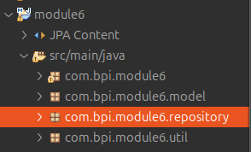
Implementation
Create repository package
ex. com.bpi.module6.repository

Slide 159
Implementation
2. Create repository interface
import java.util.List;
public interface Repository<T, ID> {
T save(T entity);
void delete(T entity);
void deleteById(ID id);
T findById(ID id);
List<T> findAll();
}

Slide 160
Repository Implementation
3. Create Implementation class of Repository Interface for each entity

Slide 161
public class StudentRepository implements Repository<Student, Long> {
private final EntityManager em;
public StudentRepository(EntityManager em) {
this.em = em;
}
@Override
public Student save(Student student) {
if(student.getId() == null) {
em.persist(student);
} else {
student = em.merge(student);
}
return student;
}
@Override
public void delete(Student student) {
em.remove(em.contains(student) ? student : em.merge(student));
}
@Override
public void deleteById(Long id) {
Student student = findById(id);
if (student != null) {
delete(student);
}
}
@Override
public Student findById(Long id) {
return em.find(Student.class, id);
}
@Override
public List<Student> findAll() {
return em.createQuery("SELECT s FROM Student s", Student.class).getResultList();
}
}

Slide 162
Repository Pattern Usage
Service Layer:
public interface StudentService {
Student enrollStudent(Student student, Profile profile);
}

Slide 163
public class StudentServiceImpl implements StudentService {
private final EntityManager em;
private final StudentRepository studentRepository;
public StudentServiceImpl(EntityManager em) {
this.em = em;
this.studentRepository = new StudentRepository(em);
}
@Override
public Student enrollStudent(Student student, Profile profile) {
EntityTransaction tx = em.getTransaction();
try {
tx.begin();
HashMap<String, String> errors = validateEnrollment(student, profile);
if (!errors.isEmpty()) {
MapPrinterUtil.printMap(errors);
if(tx.isActive()) {
tx.rollback();
}
return null;
}
student.setProfile(profile);
Student savedStudent = studentRepository.save(student);
tx.commit();
return savedStudent;
} catch (Exception e) {
if (tx.isActive()) {
tx.rollback();
}
throw e;
}
}
private HashMap<String, String> validateEnrollment(Student student, Profile profile) { //TODO }
}

Slide 164
public class App {
public static void main(String[] args) {
EntityManager em = EntityManagerUtil.getInstance().createEntityManager();
StudentService studentService = new StudentServiceImpl(em);
try {
Student newStudent = new Student();
newStudent.setName("Rose Wood");
newStudent.setAge(25);
newStudent.setEmail("rosewood@gmail.com");
Profile newStudentProfile = new Profile();
newStudentProfile.setAddress("Pasig City");
newStudentProfile.setNationality("Filipino");
studentService.enrollStudent(newStudent, newStudentProfile);
} finally {
EntityManagerUtil.getInstance().closeEntityManager(em);
EntityManagerUtil.getInstance().shutdownFactory();
}
}
}

Slide 165
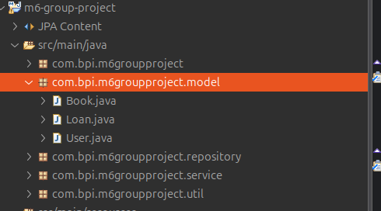
Group Project Requirements - M6
Update Library System Application
Migrate to Maven Project
import hibernate-core and postgresql dependencies in pom.xml
configure persistence.xml
configure jdbc connection
Create Entities using JPA annotations
put all entities in a single package
Create entity class for Book, Loan, and User

Slide 166
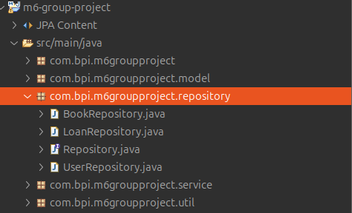
Group Project Requirements - M6
3. Practice Repository Pattern
Create repository package and put all Repository classes there
Create Repository Interface
Create Repository Implementation Class per Entity Class

Slide 167
Group Project Requirements - M6
public interface Repository<T, ID> {
T save(T entity);
void delete(T entity);
void deleteById(ID id);
T findById(ID id);
List<T> findAll();
}

Slide 168
Group Project Requirements - M6
public class BookRepository implements Repository<Book, Long> {
private final EntityManager em;
public BookRepository(EntityManager em) {
this.em = em;
}
@Override
public Book save(Book entity) {
// TODO
return null;
}
@Override
public void delete(Book entity) {
// TODO
}
@Override
public void deleteById(Long id) {
// TODO
}
@Override
public Book findById(Long id) {
// TODO
return null;
}
@Override
public List<Book> findAll() {
// TODO
return null;
}
}

Slide 169
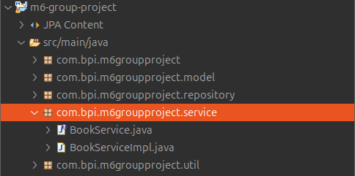
Group Project Requirements - M6
4. Retain all functionalities from Module 5 Project
Display All Books, Display Available Books, Display All Borrowed Books, Borrow Book, Return Book, Add Book, Remove Book, Update Book
try to put these functionalities in a service classes (BookService)
put service class in service package

Slide 170
Group Project Requirements - M6
public interface BookService {
void displayAllBooks();
void displayAllAvailableBooks();
void displayAllBorrowedBooks();
void borrowBook();
void returnBook();
void addBook();
void removeBook();
void updateBook();
}
Methods don’t necessarily have a void return type or no parameters; it all depends on your design.

Slide 171
Group Project Requirements - M6
public class BookServiceImpl implements BookService {
private final EntityManager em;
private final BookRepository bookRepository;
public BookServiceImpl(EntityManager em) {
this.em = em;
this.bookRepository = new BookRepository(em);
}
@Override
public void displayAllBooks() {
// TODO
}
@Override
public void displayAllAvailableBooks() {
// TODO
}
@Override
public void displayAllBorrowedBooks() {
// TODO
}
@Override
public void borrowBook() {
// TODO
}
@Override
public void returnBook() {
// TODO
}
@Override
public void addBook() {
// TODO
}
@Override
public void removeBook() {
// TODO
}
@Override
public void updateBook() {
// TODO
}
}

Slide 172
Thank You!

